Slide 1

Exploring and Fine-Tuning Large Quantitative Models (LQMs) for Financial Decision-Making
Maneth Balasooriya
Dr Qureshi
Final Presentation

Slide 2

Problem Statement
Traditional models rely on static assumptions (normality, constant volatility).
Markets are dynamic with regime shifts, tail risks, and black swan events.
Current AI models are fragmented, lacking integration in real-world finance.
Need for an adaptive AI-powered framework for financial decision-making.

Slide 3

Research Objectives
Develop
01
Develop AI-powered LQMs for institutional investors.
Integrate
02
Integrate transformer architectures and reinforcement learning.
Improve
03
Improve market prediction accuracy and portfolio optimization.
Compare
04
Compare AI models against traditional quantitative strategies.

Slide 4
Literature Review & Gaps
Traditional models: CAPM, Black-Scholes, GARCH (limited adaptability).
AI models: Deep learning, RL in finance (often used in isolation).
Lack of integration between AI and financial market modeling.
Few studies implement AI models across multiple financial applications.

Slide 5

Solution and Methodology
Develop LQMs with transformers & reinforcement learning.
Train models using financial datasets (market trends, macroeconomics).
Evaluate accuracy, robustness, and adaptability to market shifts.
Compare against benchmark financial models.

Slide 6
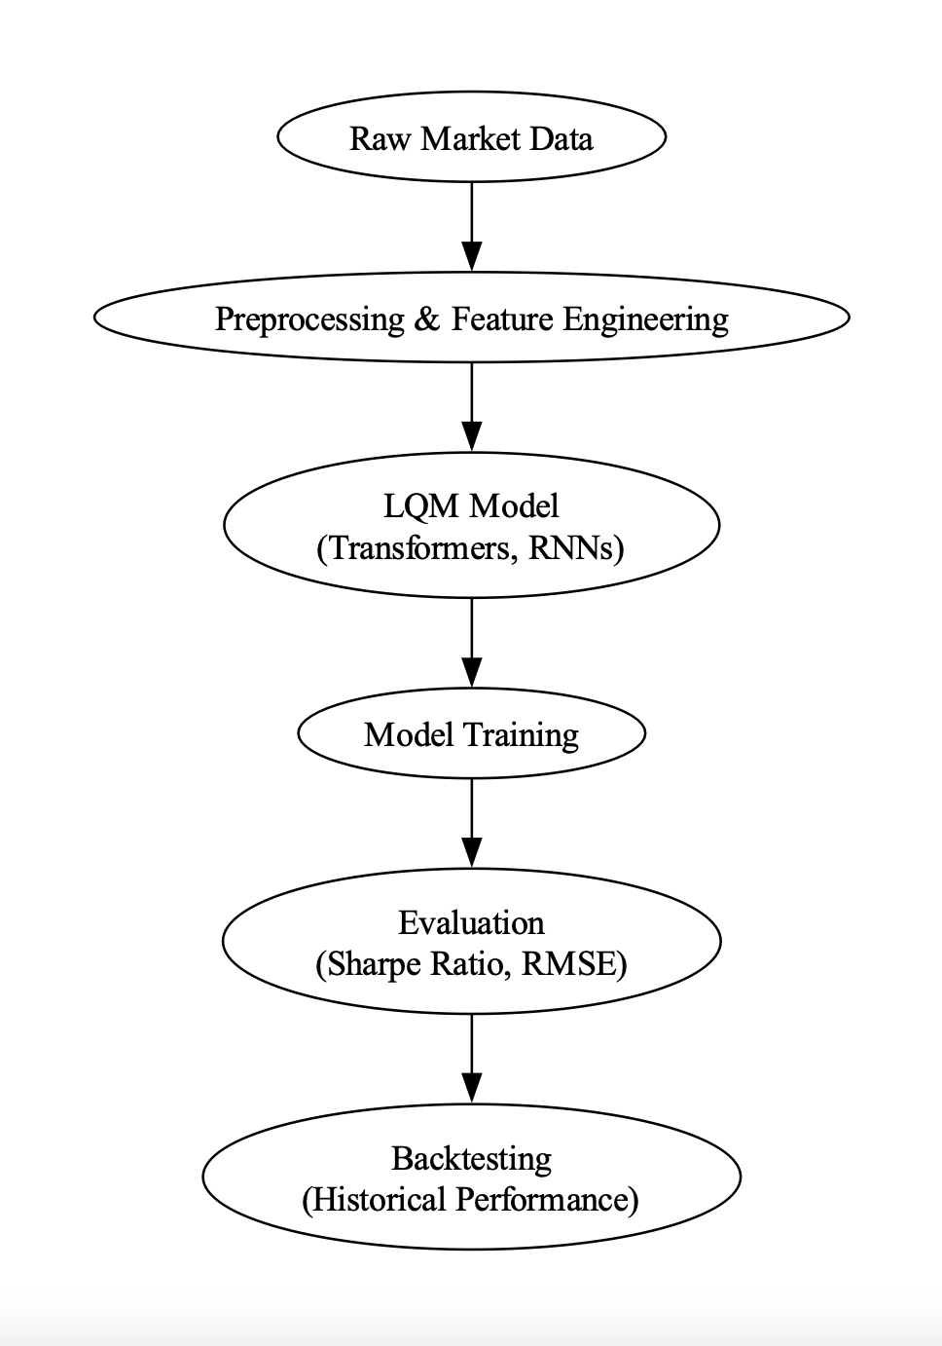
Model Architecture
Inputs: Market data, economic indicators, investor sentiment.
Processing: Transformer-based feature extraction.
Decision-making: Reinforcement learning for optimal trading.
Outputs: Asset predictions, risk assessments, investment signals

Slide 7
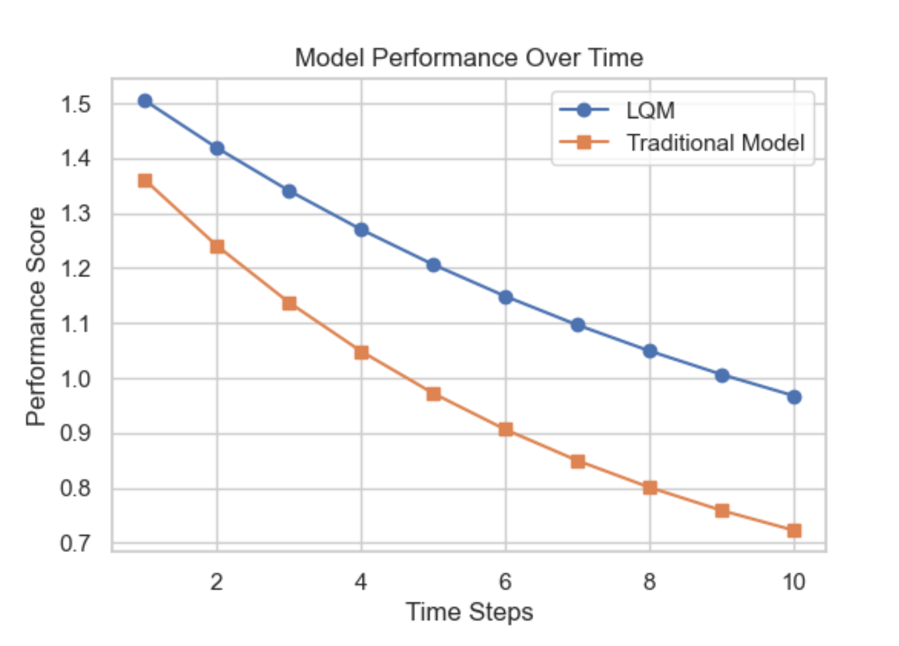
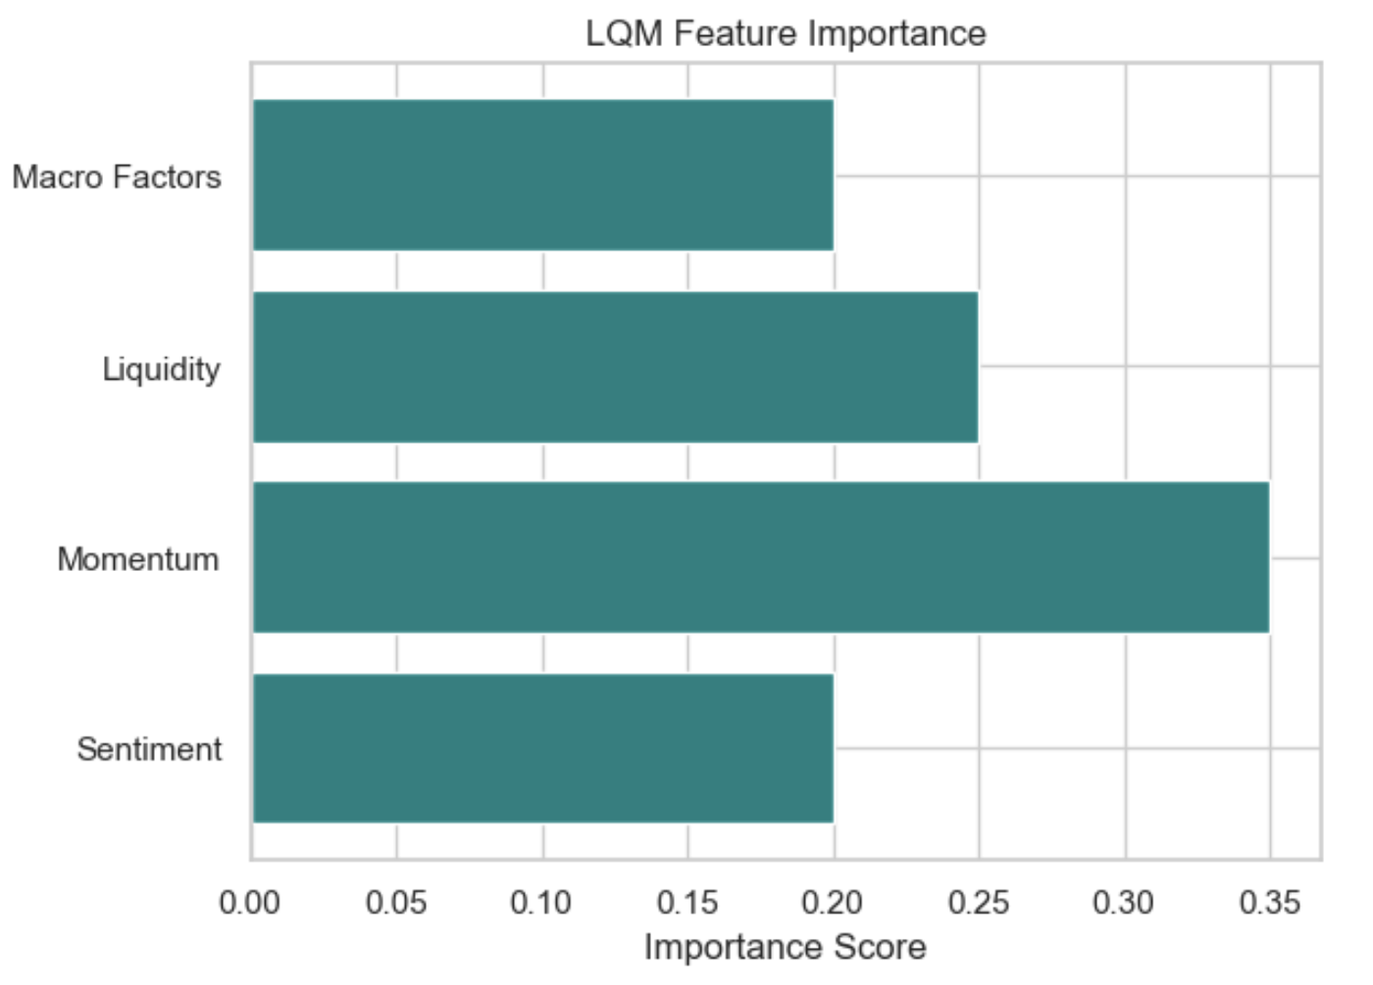
Results and Performance
LQM outperforms traditional models in prediction accuracy.
Better risk-adjusted returns in simulated trading.
More adaptive to market regime shifts.
Robustness tested against financial crises data.

Slide 8

Discussion & Implications
AI models enhance financial market efficiency.
Potential for improved risk management strategies.
Reduces reliance on static assumptions.
Encourages adoption of AI in institutional investing

Slide 9
Limitations and Future Work
Data privacy and ethical concerns in AI-driven finance.
Computational costs of training LQMs.
Model interpretability and transparency challenges.
Future: Expand models for alternative assets (crypto, commodities).

Slide 10

Conclusion & Closing Remarks
AI-driven LQMs outperform traditional financial models.
Enables more adaptive, data-driven investment strategies.
Improves risk assessment and decision-making for investors.
Future potential for broader AI adoption in finance.

Slide 11

Thank you!

